Slide 1









Whiteboardmaths.com
7
2
1
5
© 2004 All rights reserved

Slide 2
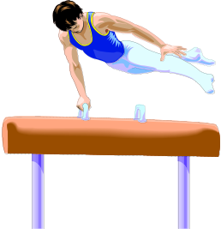
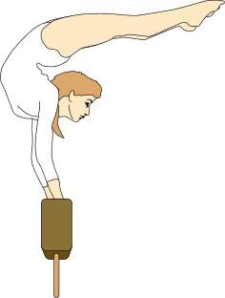

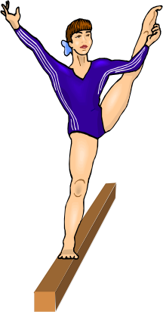

Bar-Line Graphs
50
The data below shows how many people visited a local gym each day of the week. Draw a bar-line graph for the data.
40
30
Frequency
20
Mon
30
Tue
45
10
Wed
35
Thu
20
0
Mon
Tue
Wed
Thu
Fri
Fri
40

Slide 3
Bar-Line Graphs
50
45
40
The bar-line graph shows how many people visited a local gym each day of the week.
40
32
27
30
25
Frequency
20
How many people visited on Monday?
10
How many people visited in total?
0
Mon
Tue
Wed
Thu
Fri
169

Slide 4

The bar-line graph shows information on members of a junior snooker club.
Bar-Line Graphs
20
How many of the members are 9 year olds?
10
16
What is the most common age for members?
12
14
Frequency
8
How many teenagers are members?
50
4
How many members are there altogether?
87
0
9
10
11
12
13
14
15
Age of members (years)
10 + 8 + 7 + 12 + 14 + 20 + 16

Slide 5
Bar-Line Graphs
50
The data below shows how many people visited a local gym each day of the week. Draw a bar-line graph for the data.
40
30
Frequency
20
Mon
30
Tue
45
10
Wed
35
Thu
20
0
Mon
Tue
Wed
Thu
Fri
Fri
40

